Slide 1


ECE 560
Assertion Based Verification
Assertion Based Verification for I2C-Based Memory Subsystem
Team:12
Sathwik Bandi – 981066301
Avinash Reddy Madireddy – 926067606
Thanmai Neelampalli – 963346037
Bhanu Sai Sidhardha Tummala – 987364882
Under Guidance of
Asst. Prof of Practice: Venaktesh Patil
Department of Electrical and Computer Engineering
Maseeh College of Engineering and Computer Science

Slide 2
Contents
Introduction
Block Diagram
Design Description
Assertions, Assumptions and Coverages
Timing Diagrams
Challenges
Conclusion
References

Slide 3
Introduction
The project implements a complete I²C-based memory subsystem enabled with read and write capabilities between a master and a slave device.
The subsystem includes four major components:
Functional Unit (FU) – an 8-bit universal shift register for data preprocessing
I²C Master Interface – generates all I²C protocol signals (START, STOP, ACK, address, data)
I²C Slave / Memory Controller – receives serial data, performs address decoding, and handles memory accesses
Memory Block – stores and retrieves 8-bit data
Supports multi-byte transactions, repeated START, clock stretching, and serial-to-parallel / parallel-to-serial conversion.
The system ensures protocol-correct I²C communication, proper state transitions, and reliable data transfer under all supported scenarios.
A complete Assertion-Based Verification (ABV) flow was applied, using FPV, SEQ, and coverage to validate:
protocol behavior
memory correctness
FSM sequencing
end-to-end write/read integrity
The final subsystem is fully verified, robust, and functionally consistent with I²C protocol requirements.

Slide 4
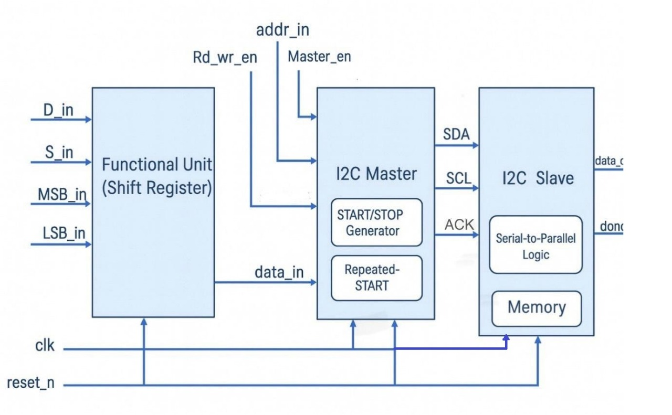
Block Diagram

Slide 5
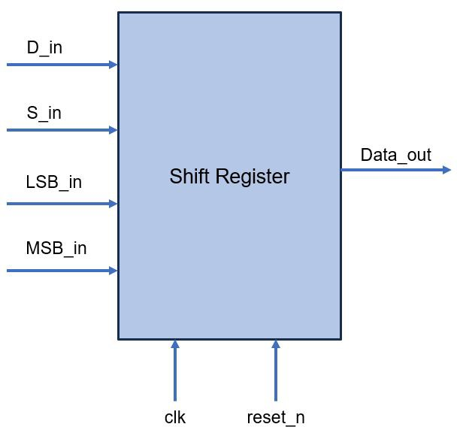
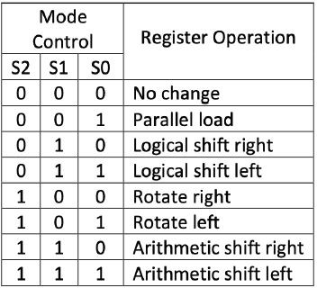
Design Description: Functional Unit

Slide 6
Design Description: Functional Unit
Implements multiple bit-manipulation operations: load, hold, logical shifts, rotates, and arithmetic shifts.
Operation selected using a 3-bit control input (S_in).
D_in (8-bit) provides the parallel data for load operations.
MSB_in and LSB_in supply serial bits during left and right shifts.
Internally built using multiplexers + D-flip-flops for reliable timing.
Produces processed 8-bit data_out that is forwarded to the I²C Master.
Supports all shift/rotate modes required for data preprocessing before memory access.
Fully verified using formal checks to ensure correct output for every shift mode.

Slide 7
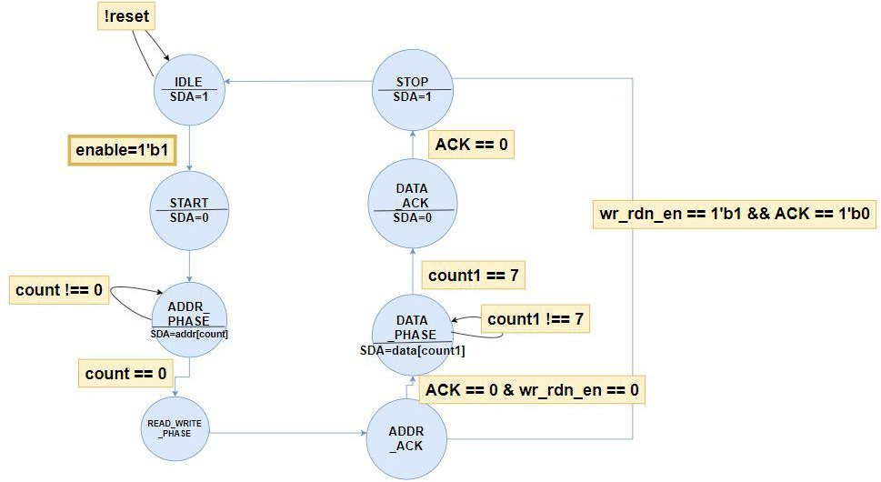
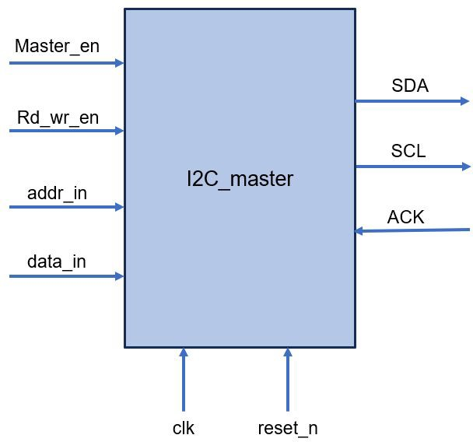
Design Description: I2C Master

Slide 8
Design Description: I2C Master
Implements full I²C protocol using a finite state machine (FSM).
Generates START/STOP, address bits, R/W bit, data bits, and samples ACK from the slave.
Begins a transaction when Master_en is asserted with valid address, data, and R/W fields.
Supports both write (0) and read (1) operations using wr_rdn_en_in.
Receives addr_in (8-bit) and data_in (8-bit) for write sequences.
Drives SDA and SCL_drv signals according to I²C timing rules; both idle high after reset.
Handles multi-byte transfers, repeated START, and proper ACK synchronization.
Uses internal counters to track bit positions and burst transfers.
Ensures correct sequencing: START → Address → R/W → ACK → Data → ACK → STOP.
Fully verified using FPV to confirm all state transitions and signal behaviors.

Slide 9
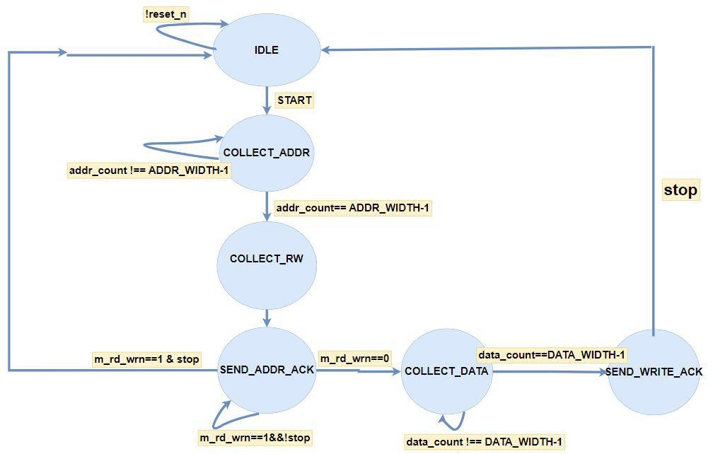
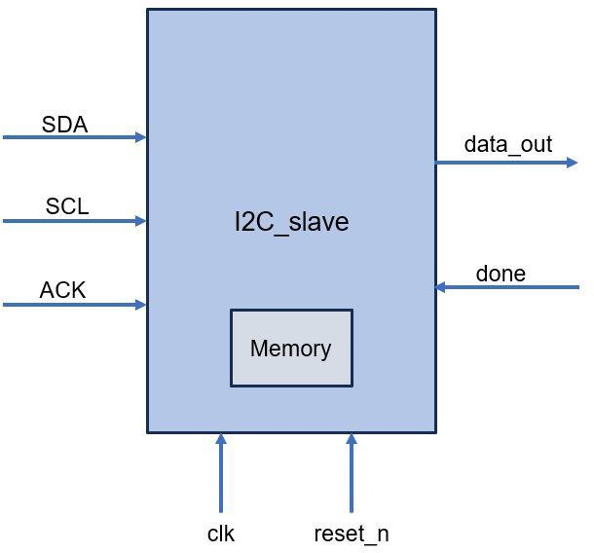
Design Description: I2C Slave

Slide 10
Design Description: I2C Slave
I²C Slave (Memory Controller + Serial Interface)
Receives serial address, R/W bit, and data from the I²C Master through SDA and SCL.
Converts incoming serial bits into parallel address/data using internal bit counters.
Performs address validation: accepts legal addresses (0–127) and rejects illegal ones (128–255).
In write mode, collects 8 serial data bits and updates the internal memory at the decoded address.
In read mode, retrieves the stored byte from memory and outputs it on data_out with done asserted.
Generates ACK only for legal addresses and valid data reception.
Supports clock stretching using scl_stretch_n to hold SCL low during processing delays.
Returns to the IDLE state on STOP detection and maintains proper I²C timing behavior.
Fully verified using FPV to ensure protocol accuracy, correct state transitions, and safe memory access.

Slide 11
Assumptions
Reset is applied at the beginning and the clock is free-running.
Master_en behaves like a proper handshake signal and is not toggled randomly.
SDA and SCL remain stable when SCL is high (except during START/STOP).
Address and data inputs provided to the master are always valid 8-bit values.
No illegal or unrealistic I²C transitions occur in the formal environment.
Only one read/write transaction is active at a time unless repeated START is used.
Slave is assumed to respond only within valid protocol timing.
Prevents the formal tool from exploring unreachable or meaningless states.

Slide 12
Assertions
Assertions (Protocol + Functional Verification)
D Flip-Flop Assertions:
Q follows D on rising clock edge; async reset forces Q = 0.
8-to-1 Mux Assertions:
Output matches the selected input for every value of select.
Shift Register Assertions:
Correct behavior for load, hold, shift, rotate, and arithmetic shift modes.
I²C Master Assertions:
Valid FSM transitions through START → ADDR → R/W → ACK → DATA → STOP.
Correct SDA/SCL behavior for data and ACK phases.
Proper ACK sampling and repeated START operation.
I²C Slave Assertions:
START/STOP detection correctness.
Serial-to-parallel assembly for address and data.
Memory write only for legal addresses.
DONE asserted only for valid read sequences.
ACK generated only when address is legal.
Protocol-Level Assertions:
SDA stable when SCL is high (except START/STOP).
End-to-end write→read returns the same stored data.

Slide 13
Coverage
Coverage (Functional + Protocol Coverage)
Master Coverage:
Both read and write operations exercised.
Different burst lengths and multi-byte transfers covered.
Repeated START scenarios observed.
Cross-coverage between R/W mode, burst size, and ACK behavior.
Slave Coverage:
Legal and illegal address accesses both covered.
Memory read/write paths fully exercised.
Clock stretching active vs inactive.
All FSM states observed.
Data Coverage:
Full 0–255 value range divided into bins for data_in and data_out.
Ensures wide variety of data patterns are explored.
Ensures verification completeness for protocol, timing, and memory behavior.

Slide 14
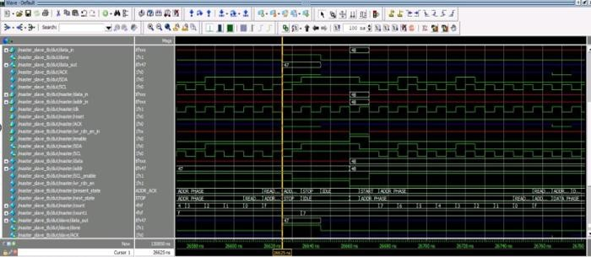
Timing diagrams
READ:

Slide 15
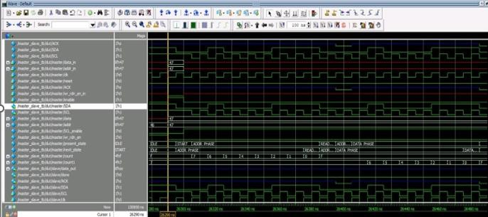
Timing diagrams
WRITE:

Slide 16
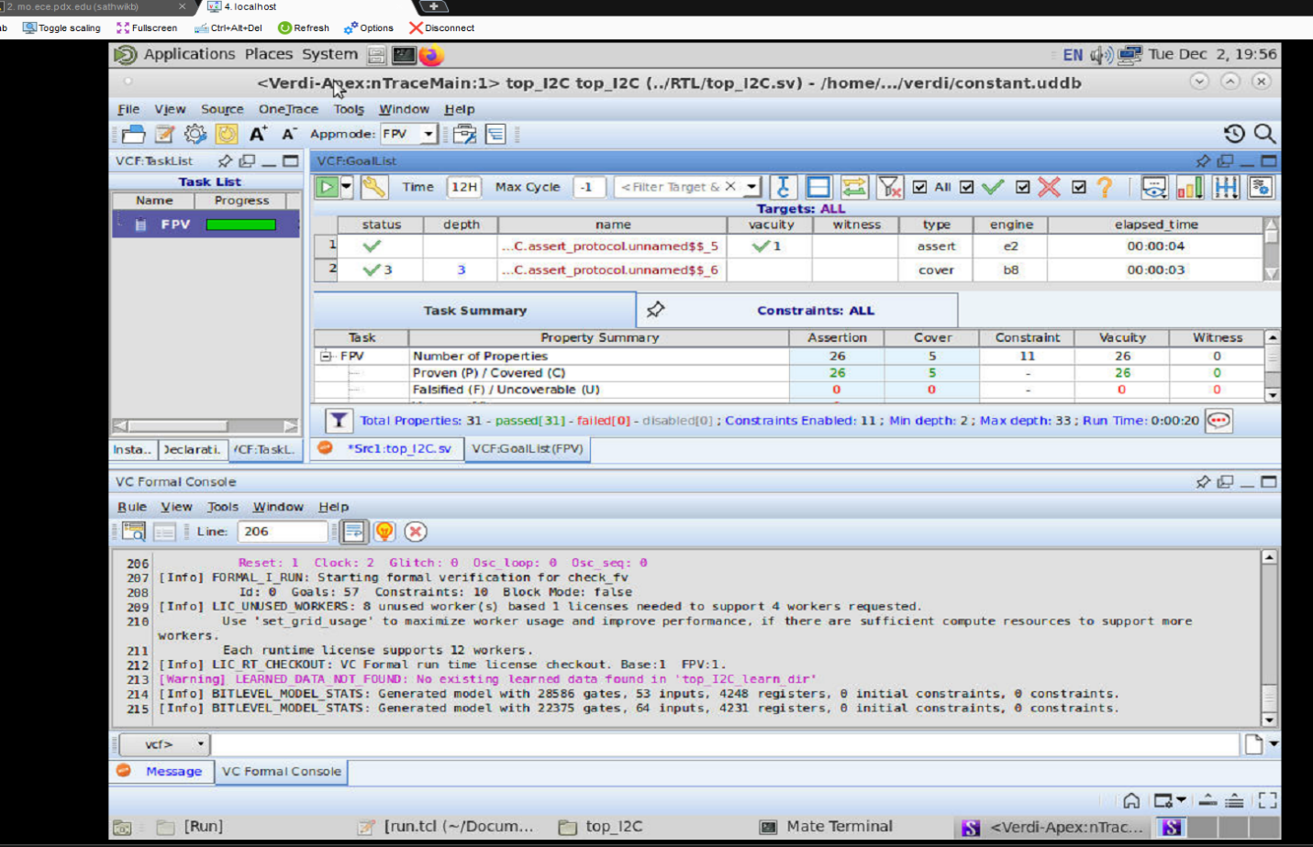
Results
I2C_top(FPV app Mode):

Slide 17
Challenges
Synchronizing the Master and Slave FSMs was difficult due to differences in signal edges and protocol timing.
Initial protocol assertions (especially SDA stability when SCL is high) produced false failures and required refinement.
STOP/termination detection failed in formal runs because of clock-stretching delays; timing conditions had to be adjusted.
Slave assertions failed for ACK and DONE signals after adding illegal address handling (0–127 valid, 128–255 invalid).
End-to-end properties failed because the formal tool explored unrealistic sequences (multiple writes before read, random reads).
Required adding assumptions to restrict the environment to valid I²C behavior.
Compilation issues occurred due to missing imports, mismatched enum names, width mismatches, and duplicate parameters in SVA modules.
Debugging interactions between bit counters, FSM states, and serial-to-parallel conversions took multiple iterations to stabilize.

Slide 18
Conclusion
Designed and implemented a complete I²C-based memory subsystem including a Functional Unit, I²C Master, I²C Slave, and Memory.
Functional Unit performs preprocessing using an 8-bit universal shift register supporting load, shift, and rotate operations.
I²C Master and Slave were modeled as FSMs handling address decoding, data transfer, ACK/NACK, repeated START, and clock stretching.
Subsystem supports legal/illegal address detection, multi-byte transfers, and protocol-accurate communication.
Assertion-Based Verification was applied across all modules using FPV, SEQ, and functional coverage.
Verified protocol correctness, memory integrity, state-machine sequencing, and end-to-end write→read consistency.
Final results demonstrate that the design is functionally correct, protocol-compliant, and fully verified under all supported I²C scenarios.

Slide 19
References
Texas Instruments – I²C Application Notes & Design Guidelines
NXP Semiconductors – I²C-bus Specification and User Manual (UM10204)
CircuitBasics – Basics of the I²C Communication Protocol
Microchip – Understanding the I²C Bus
Analog Devices – Designing Robust I²C Systems
Intel – I²C Controller Architecture Application Notes
IEEE 1800-2017 – SystemVerilog Language & Assertions Standard
Verification Academy – SystemVerilog Assertions & Formal Verification Tutorials
Synopsys – VC Formal User Guide
ARM – AMBA & Peripheral Bus Architecture Documentation

Slide 20
THANK YOU

